Slide 1
Space, Time and Visual Analytics
Gennady Andrienko et al. , 2010
Liam Tyler (lgt2621)
and
Kaleem Nawaz Khan (kk5271)

Slide 2
Introduction
Visual analytics: Combine the strengths of human and electronic data processing
Humans and computers cooperate through graphics
Spatio-temporal data and solving spatio-temporal problems are of special interest
Spatio-temporal GDP data
Both professionals and common audience usually interested in spatio-temporal data analysis
There is a need to devise approaches to deal with the complexities of this data and problems
Also, to make analytical tools accessible and usable for the broad spectrum of potential users

Slide 3
Brief History of Geospatial Visualization
Geographic Information Science (GIScience)
Explores how to use and understand geographic data
GeoVisualization
Visual representations of geospatial data
Facilitates the design and use of new maps/models/functionality/etc.
GeoVisual Analytics
Everyone is a spatial temporal analyst
Think Temporally!

Slide 4
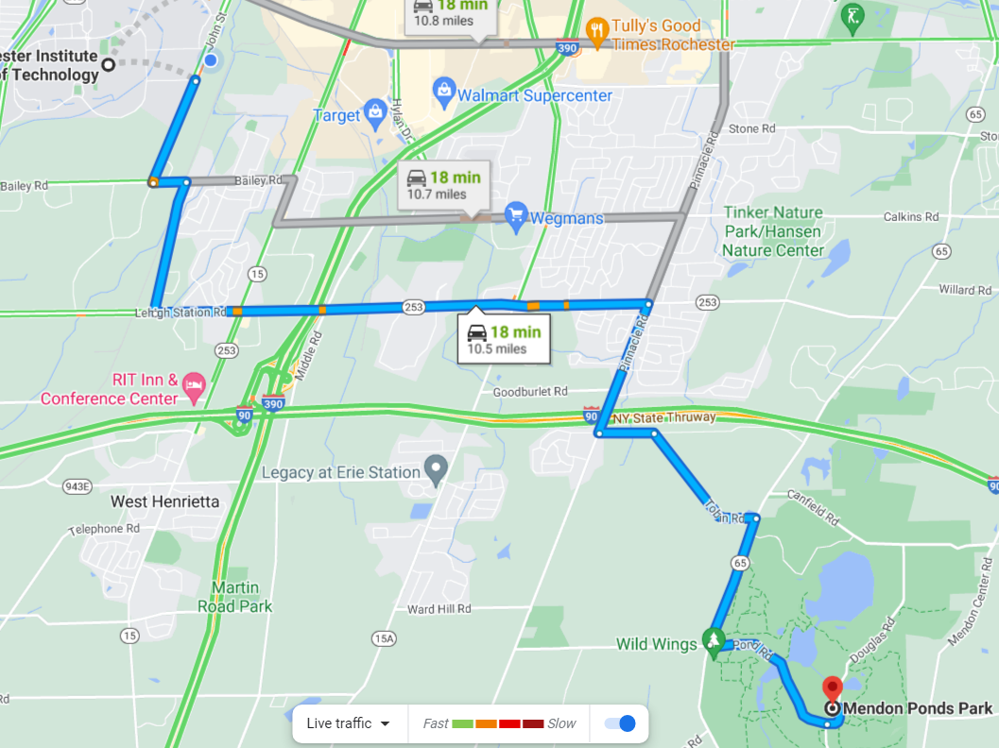
Everyone is a Spatial Temporal Analyst
Everyone uses spatial and temporal data
Planning a trip
Checking the weather
Community is potentially unlimited

Slide 5
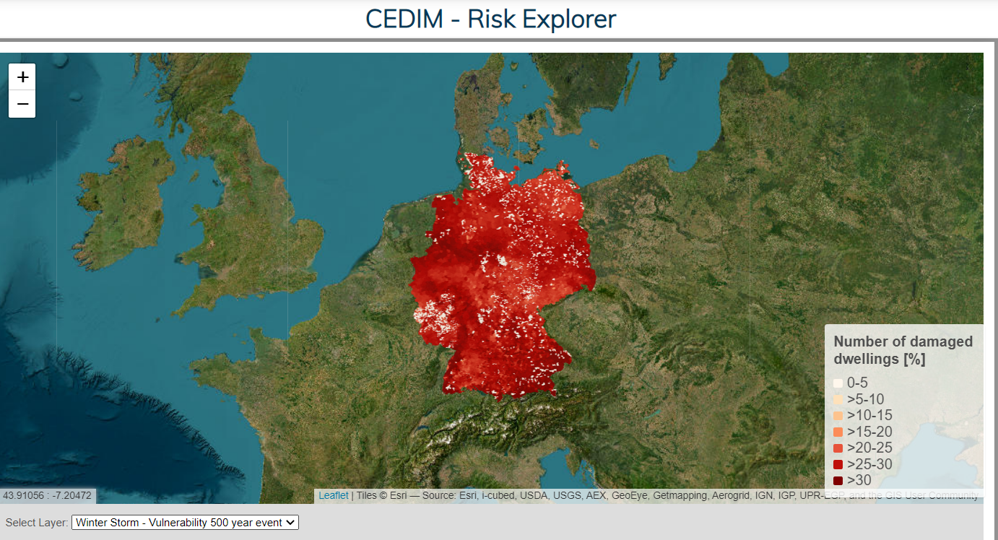
An Example Town
Provides an example of a town after a hailstorm
Explores scenario from multiple views
Insurance agent
Family
Decision Makers (Politicians)
Community

Slide 6
Think Temporally!
Often only focus on the spatial aspect of geovisualization
Time has a hierarchy of granularities
Seconds, minutes, hours, days, …
Time can contain cycles
Natural or Social
Can be predictable

Slide 7
Temporal Primitives
Time points - an instance in time
Time intervals - a range of time

Slide 8
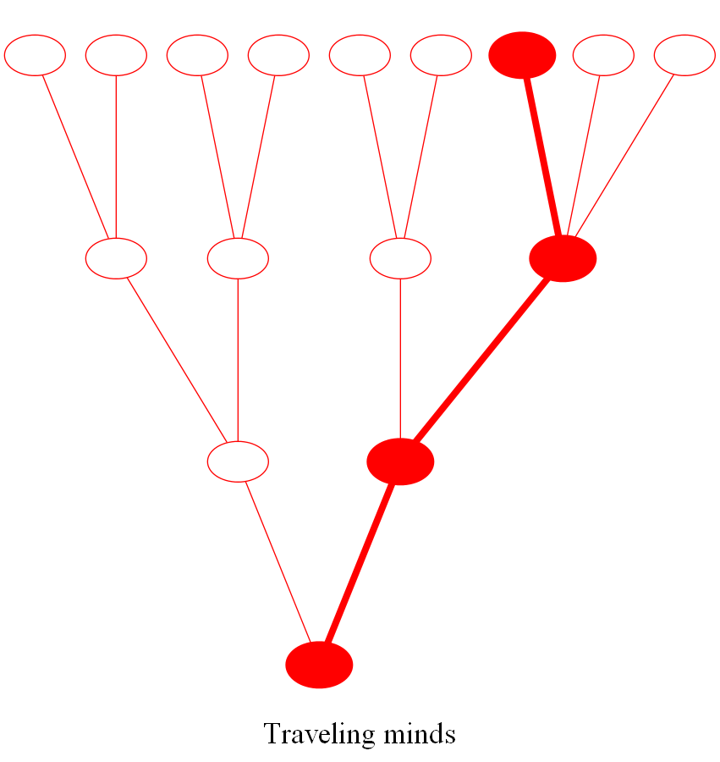
Structural Organization of Time
Ordered
Linear - a continuous series of temporal primitives
Cyclic - a finite set of recurring temporal primitives
Branching
Explores possible alternative scenarios
Good for planning and prediction
With multiple perspectives
Explores an instance of time from multiple points of view

Slide 9
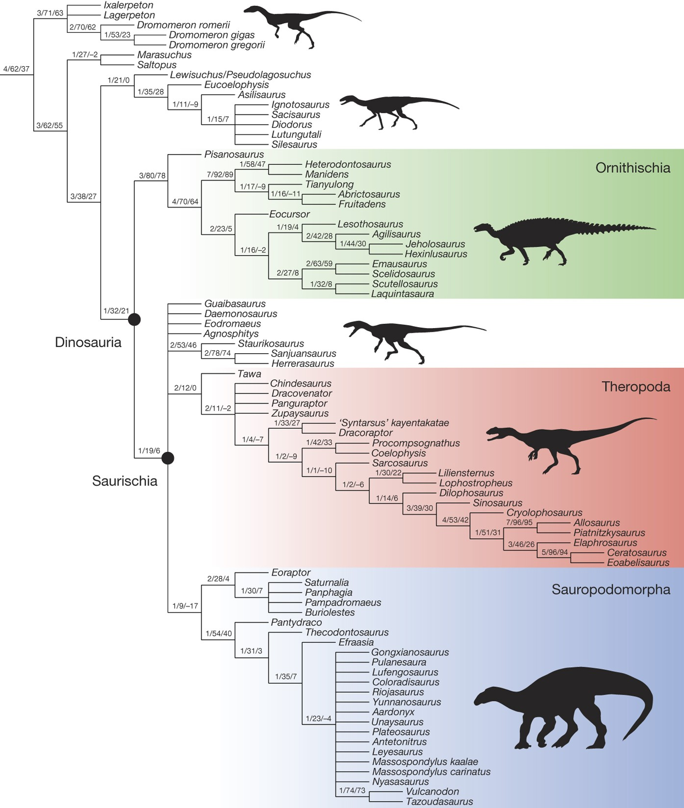
Tobler’s First Law
“Everything is related to everything else, but near things are more related than distant things”
Correlation between similar locations can be positive or negative
Spatial and Temporal observations cannot be independent
Allows for interpolation/extrapolation of data

Slide 10
Tobler’s First Flaw
Tobler’s law is not always true
Uniqueness of values
Artificial Boundaries
Interrupting events
Direction

Slide 11
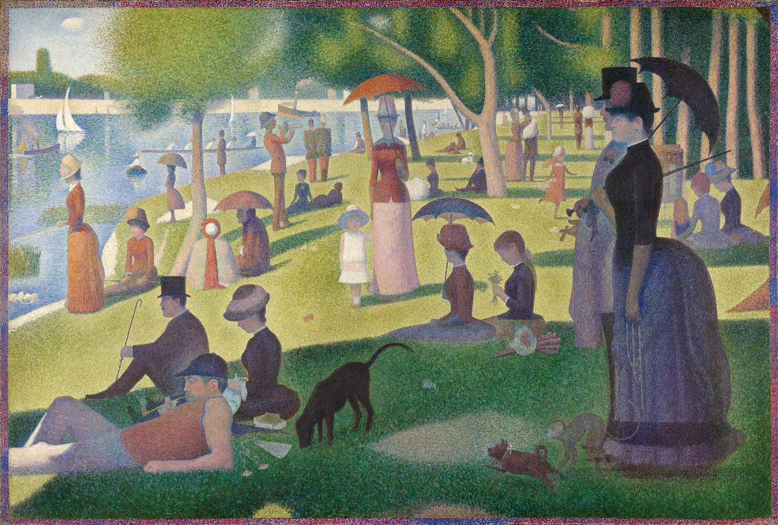
Scale
Choosing an appropriate scale is important
Trends may only be visible at certain scales
Trial and error
Different scales can interact
Larger event composed of many smaller events
Difficult to combine data with different scales

Slide 12
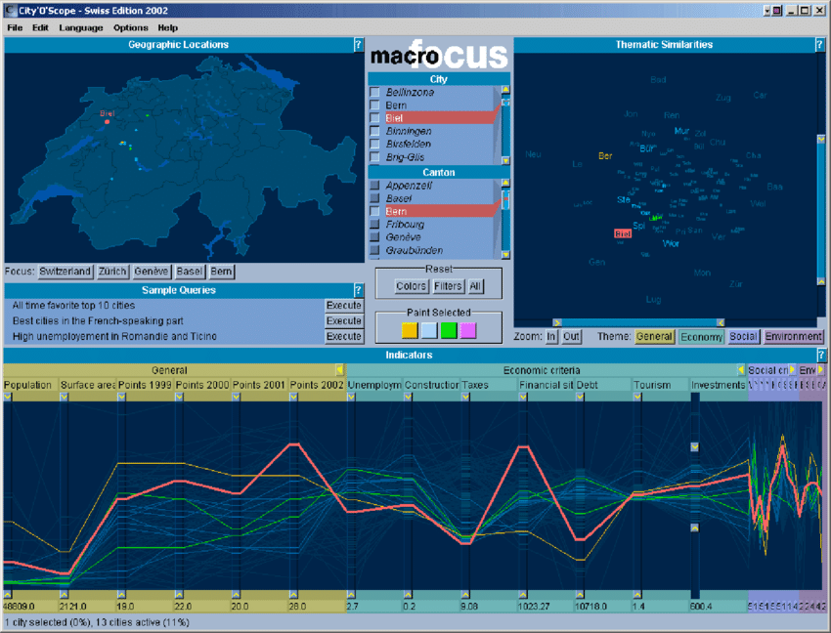
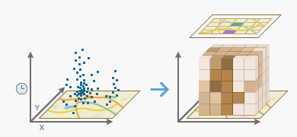
Spatial-Temporal Visualization
Cartography
Interactive Maps
Animated
Space-time cube
Coordinated Multiple views

Slide 13
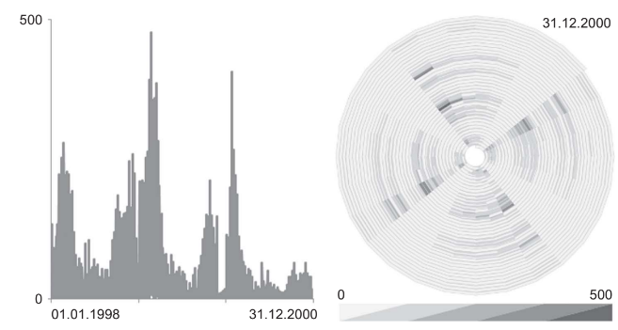
Issues Visualizing Time
Linear vs Cyclic time
Cyclic patterns may be hard to see in a linear representation
Temporal primitives
Unclear how to deal with uncertain/fuzzy temporal primitives
Branching time and time with multiple views
Few representations available
Univariate
Cannot combine with spatial data

Slide 14
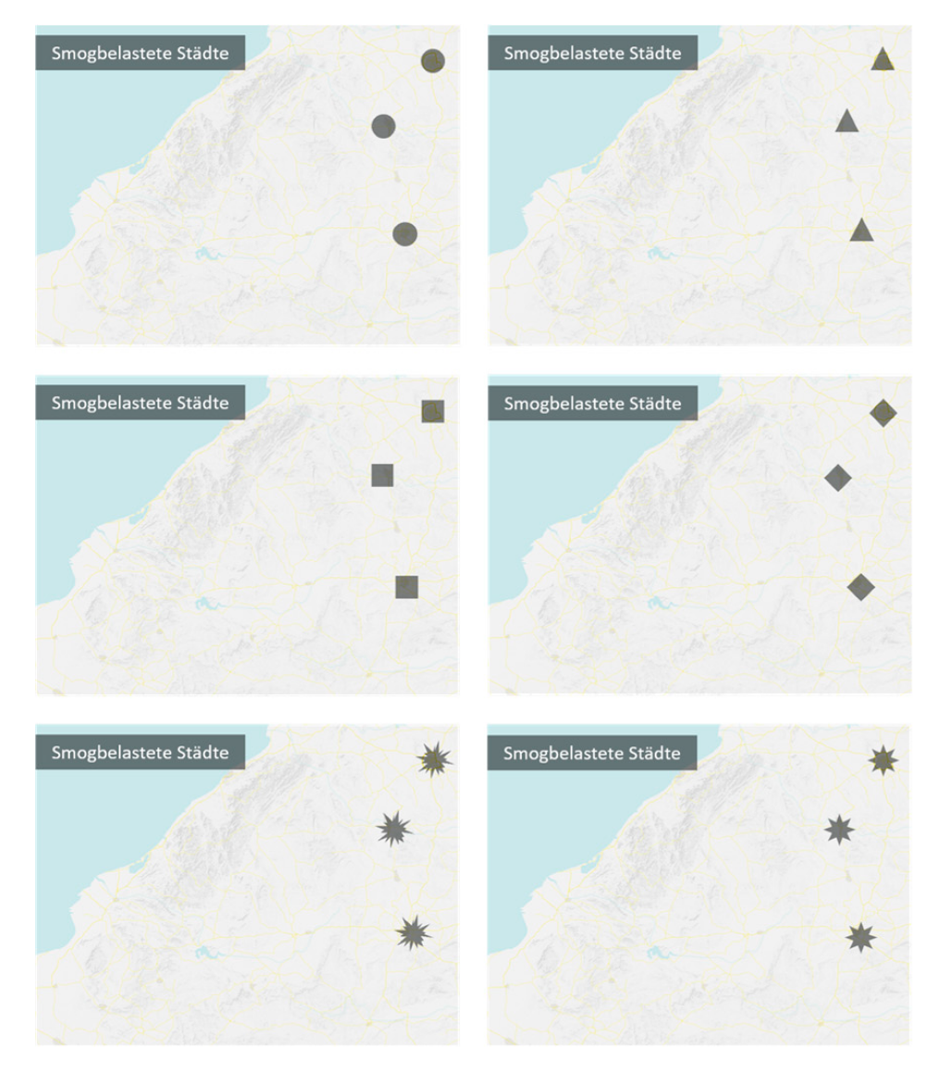
Effectiveness of Visual Techniques
Visual analytic techniques often aren’t empirically tested
Present users graphs with slight variations to determine their effect
Often done in cartography
Effectivity/efficiency of techniques depends on the task

Slide 15
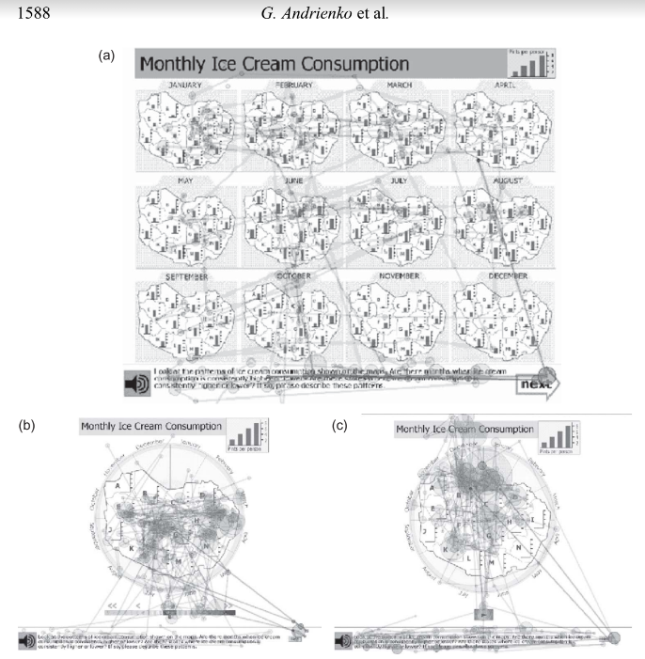
Study Example
Gaze patterns varied per map
Static map emphasized spatial patterns
Interactive maps emphasized change and events
Not all tools are used

Slide 16

Collaborative Visuals
Independent vs collaborative work impacts perception
Collaboration
Enable many users to work together on the same visualization regardless of locality
Communication
Effectively transfer information between users

Slide 17
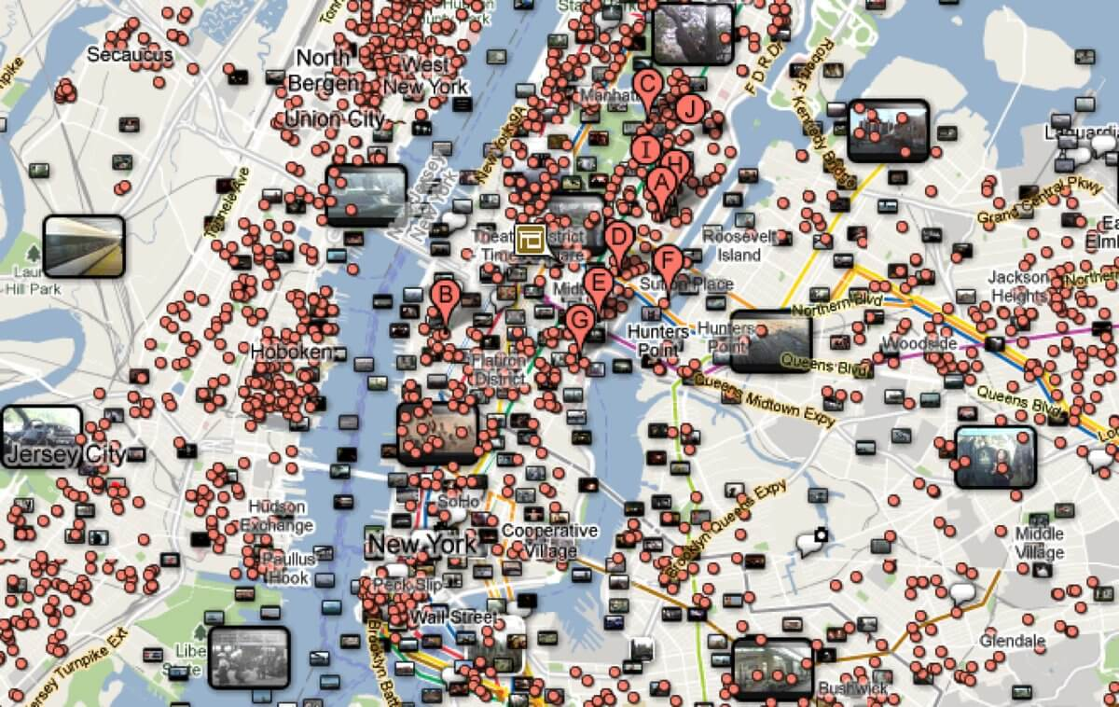
Large Data Sets
Datasets are getting larger and more complex
Direct depiction of data is ineffective
Too cluttered to easily interpret visualization
Too slow to effectively process user interactions

Slide 18
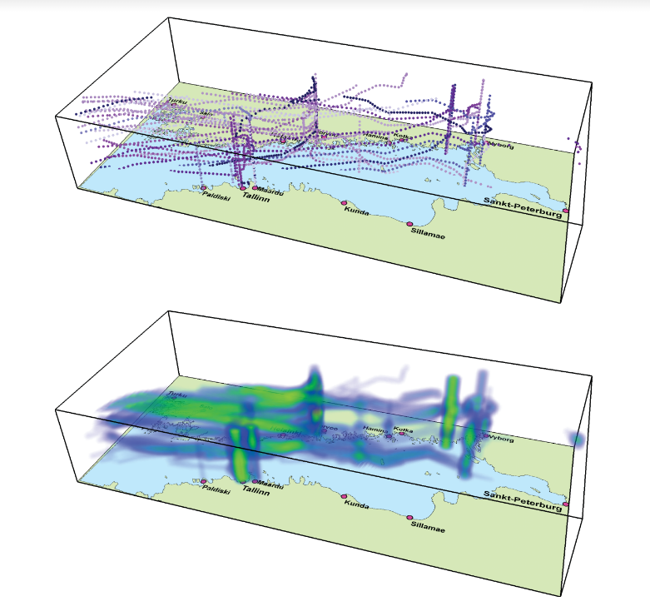
Data Aggregation
Combine data points to limit data to be displayed

Slide 19
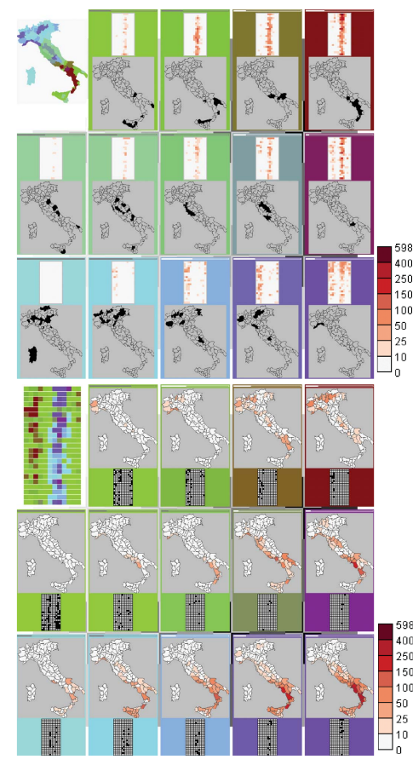
Data Mining
Extract specific features/patterns prior to visualization

Slide 20
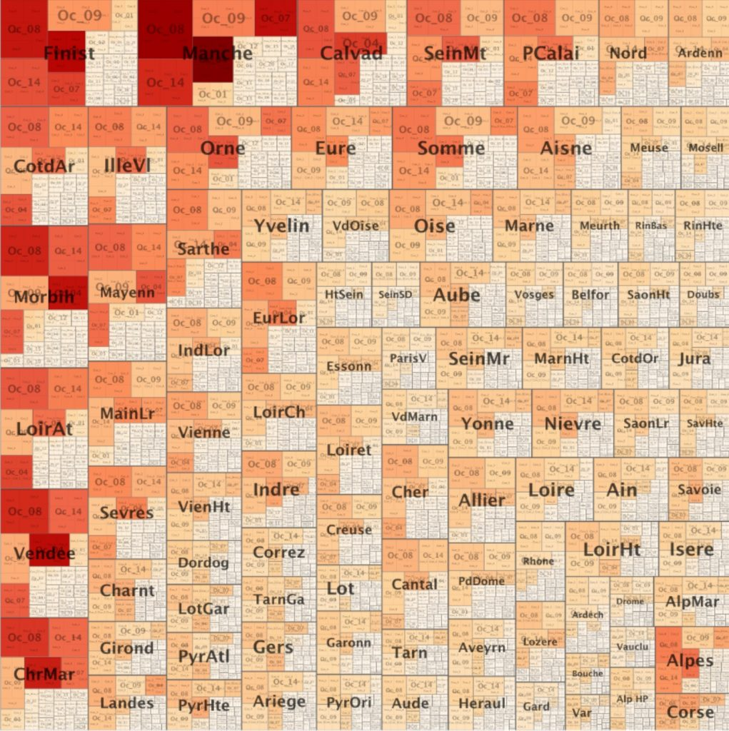
Focus Less on Location

Slide 21
Diverse Datasets
Spatial Temporal data is becoming more available
More data being generated
New frameworks, standards, and legislation makes data more accessible
Introduces many issues
New types of data
Too much data
Dynamic data
Diverse data
Inconsistencies across datasets

Slide 22
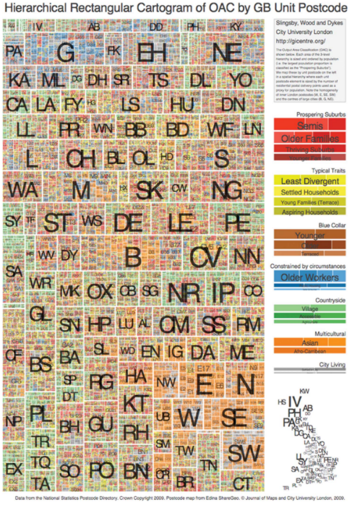

Slide 23
Enable Integrated Processing
Fill incomplete data
Harmonise inconsistencies
Refine data/derive new characteristics

Slide 24
Deal with Uncertainty
Accuracy
Precision
Completeness
Consistency
Lineage
Currency
Credibility
Subjectivity
Interrelatedness

Slide 25
Supporting Multiple Scales
Interactive visuals can help with finding an appropriate scale
Need to determine appropriate visuals for different scales
Changing scales need to be easy and allow for comparison
Need determine how to graph across various scales

Slide 26
Support Diverse Users
Tools need to be effective for a wide range of analysts
Users have prior experience with interactive displays and spatial-temporal data
Can’t train users how to reason about data or a tool
Visual representations need to foster reasoning
No design rules or guidelines for interactive maps
Unclear what techniques improve a visualization effectiveness

Slide 27
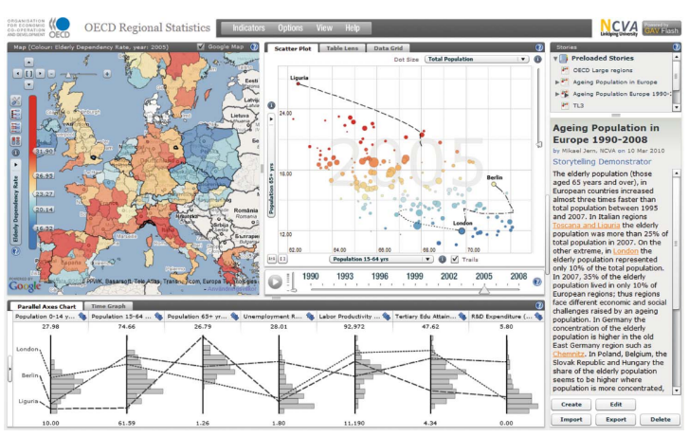
Reach the Users
New tools should be lightweight, easily deployable, and accessible
Web based
API based
Need to seamlessly integrate visualizations and spatial-temporal computation techniques
Should support documentation/reporting functionality
Should support collaboration

Slide 28
Questions

